Slide 1
Presentation Promise
No sales approach or favoritism but will be opinionated.
(we will let you know what’s working and who is doing very clever things).
Open book on Rosendin’s experience with large power systems.
Based on:
35 years of experience
Over 2,200 MW of installed critical power installed
Over 600 MW of manufactured systems produced
Three continents
Open, honest and without prejudice.
Any question is fair game ex confidential info.
Will offer tools for your success.

Slide 2
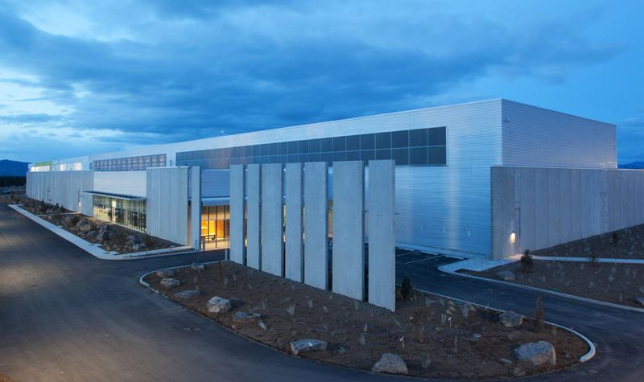
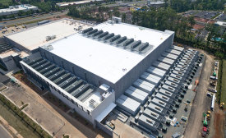
Rosendin Electric
Founded in 1919.
Employee Owned Since 1992.
Over $2.2B Revenue in 2016.
6,500 Employees Worldwide with 9.9M craft hours delivered in 2016.
Over $700M in Data Center Construction in 2016.
Over $80M in Manufactured Power Systems in 2016
Via Modular Power Solutions (MPS)
Over 9.9M craft hours delivered in 2016
Leaders in Renewable Energy, High Tech Manufacturing, Data Centers, Large-Scale Entertainment and Mixed Use.

Slide 3
Power System Integration and Optimization—Keep Your Lamborghini Out of a Ditch
Presented by: William P. (Bill) Mazzetti, Jr., P.E.
Credit: 1 AIA LU; 0.1 IACET CEU
AIA Course Number: MC13117

Slide 4
Credit earned on completion of this course will be reported to AIA CES for AIA members.
To receive a Certificate of Completion you must complete and pass the 10-question quiz following this presentation with an 80% or higher, then a certificate of completion will be available for immediate download.
This course is registered with AIA CES for continuing professional education. As such, it does not include content that may be deemed or construed to be an approval or endorsement by the AIA of any material of construction or any method or manner of handling, using, distributing, or dealing in any material or product.
Questions related to specific materials, methods, and services will be addressed at the conclusion of this presentation.

Slide 5
Learning Objectives
After viewing this webinar, you should be able to:
Describe how system automation assists in improving system performance and energy consumption.
Explore how cloud-based monitoring affects current and future approaches to automation and monitoring.
Identify the biggest trends and busts of automation and system integration.
Examine the best methods of presenting and selling automation and monitoring improvements to management and customers.

Slide 6
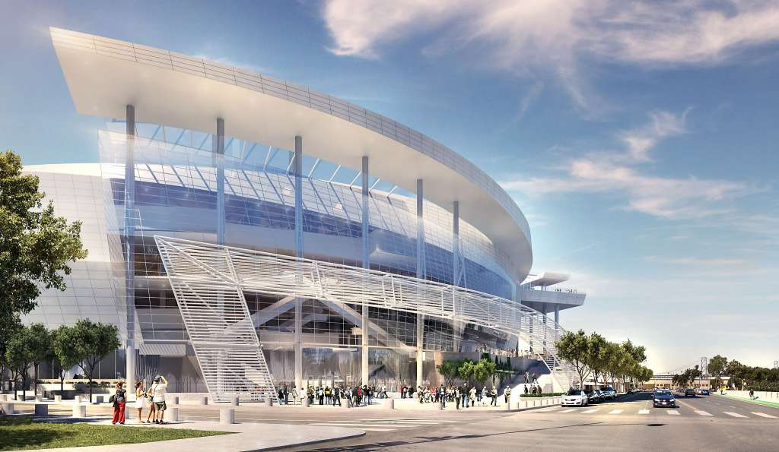
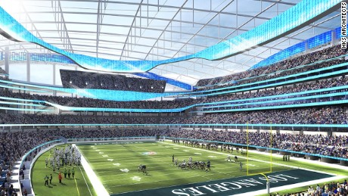
Why Integrate?
Compulsory
Deliver the complete SOO for the power system
Business relevance - trending, monitoring, data farming and interconnection
Optional
Energy efficiency/optimization
Predictive maintenance
Came with equipment you bought
“Cool” or wow factor

Slide 7
issues
Monitoring is Not Integration.
Everything starts as a closed system.
Systems are procured in silos.
No holistic optimization without integration.
Vendor-centric by system and naturally non-collaborating.
Integration is always custom and must break silos.
Security is often bollocks.
Far behind the computer science for code, security and analytics.
Captive to a vendor for an entire tech cycle = like IT was in the 80’s and 90’s.

Slide 8
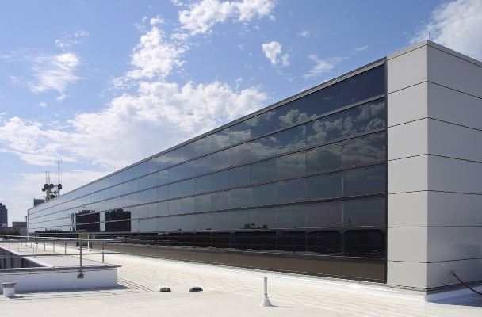
Integration Layers
Overall Control & Data Mine
MEP System Integrator
Facility Dashboard
Interconnection
SCADA
EPMS
Resident to OEM Equipment
UPS
Generator
PDU
Circuit Breaker
Switchgear
Enterprise Dashboard

Slide 9
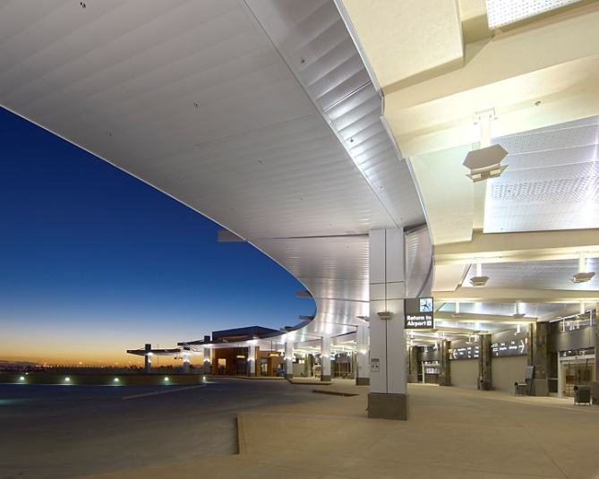
OEM Equipment Integration
Individual
Local controls handle safety – vibration, cranking, batteries, fuel feed.
Collaborate
Individual units communicate availability & cooperate with central control
Serve the Load
Central control wheels power, directs sources and has overall failure and maintenance mode reactions.

Slide 10
Interconnection
EPMS or SCADA
Power Monitoring
- Metering
- PQ Monitoring
- PUE/Metric Measurement
Critical Power Equipment
- UPS Power Mods
- Static Switches
- PDUs / RPPs
- IT Power Busway
- Plug Strips
Source Management
- Utility/Gen Transfer
- Source Control
- Source/Source Transfer (ATS)
Non-Critical Power Equipment
- Switchgear
- Generators
- Circuit Breakers

Slide 11
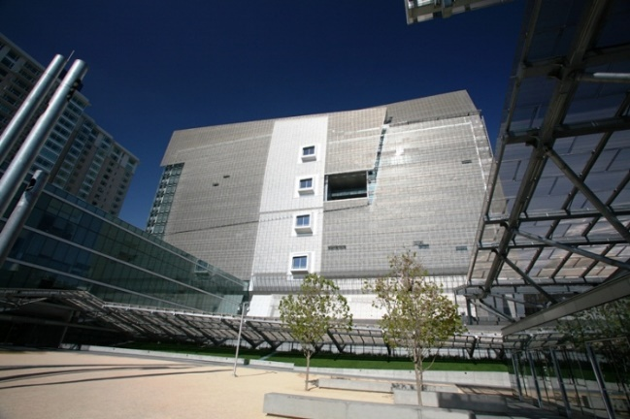
Overall Control/Data Mine
Business
Intelligence
Electrical / EPMS / SCADA
Security
Mechanical
Network
Business Operations

Slide 12
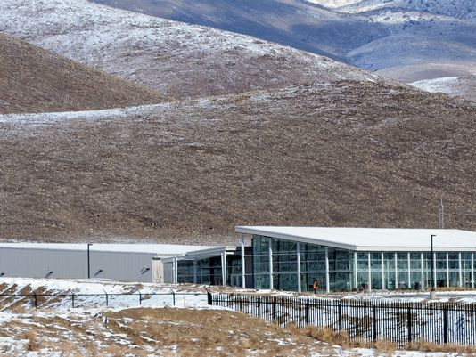
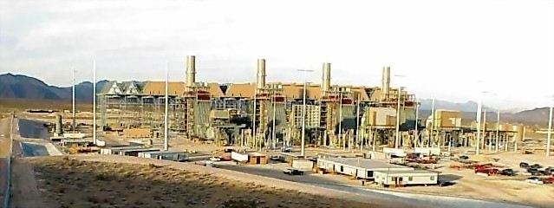
Integration Observations
Local control.
The more critical the activity, the simpler the action.
Compartmentalize automatic responses and control.
Focus on info & condition reporting.
Integration must streamline monitoring.
Have the data mine and endgame data usage in mind.
Move toward open-protocol programming (think LitBit)
It doesn’t happen by magic.

Slide 13
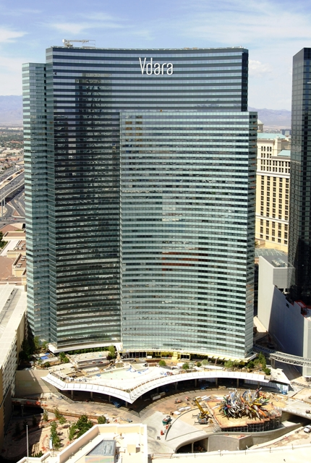
Cloud, Edge or local?
Local / OEM – On Board Equipment
Automatic Controls Manually Initiated Activities
Interlocks
Edge / EPMS – Central Electrical Monitoring & Control
Low-Latency Interaction
May be SaaS or Owned
Cloud / BI – Enterprise-Level Software
Data Mining & Trending
Owned
Covers Entire Electrical System
Highly Specific to Equipment
System Response Not Related to Automatic Function
Interaction with Non-Electrical & Non-Building Systems
May Include Automatic or Manual Activities

Slide 14
Security
Laughably poor:
Target breach.
John “Password” Podesta.
Fall 2016 DDOS attack on XYZ.
Lack of network compartmentalization.
Measures:
Same in security as the IT system it supports.
Air gap your EPMS or SCADA – Alpha Guardian.
www.alphaguardian.com
Not everyone gets access.
Vigilance.

Slide 15
Questions?
This concludes the American Institute of Architects Continuing Education Systems course.
THANK YOU FOR YOUR ATTENDANCE.
Please go to the CE Center to complete the quiz and receive your certificate.
Continuing Education: ceu@bnpmedia.com Webinars: webinars@bnpmedia.com
William P. (Bill) Mazzetti, Jr., P.E.
Senior Vice President & Chief Engineer
Rosendin Electric, Inc.
bmazzetti@rosendin.com
15

